Slide 1


Guatemala SQL Server group
February 2019

Slide 2

Christian Araujo @charaujo
Carlos Lopez @CarlosLopezSQL
Eduardo Pivaral @EduardoDBA
Carlos Robles @dbamastery
* Allan Fong @omegagt
gtssug.pass.org
Board Members

Slide 3

Upcoming Virtual Group Webinars
Virtual Group | Meeting Date | Time | Topic | Website
DBA Fundamentals | Mar 5, 2019 | 17:00 – 18:00 (UTC) | Stored Procedure Optimization Techniques - Kimberly Tripp | fundamentals.pass.org
Professional Development | Mar 8, 2019 | 19:00 – 20:00 (UTC) | Networking 101: Building professional relationships - Ray Kim | professionaldevelopment.pass.org
DBA Fundamentals | Mar 12, 2019 | 01:30 – 02:30 (UTC) | Where Should My Data Live (and Why)? - Matt Gordon | fundamentals.pass.org
DBA Fundamentals | Mar 19, 2019 | 16:00 – 17:00 (UTC) | Administering Beyond the Speed of Light: Managing SQL Server with Ansible - Brian Carrig | fundamentals.pass.org
Global Italian | Mar 20, 2019 | 17:00 – 18:00 (UTC) | Mappe personalizzate in Power BI - Andrea Martorana Tusa | globalitalian.pass.org

Slide 4
Upcoming Virtual Group Webinars
Virtual Group | Meeting Date | Time | Topic | Website
DevOps | Mar 21, 2019 | 21:00 – 23:00 (UTC) | MVP Lightning Talks From the MVP Summit - Grant Fritchey | devops.pass.org
Mar 26, 2019 | 16:00 – 17:30 (UTC) | Divide and Conquer - Relational Division with SQL - Ami Levin | globalhebrew.pass.org | Mar 26, 2019

Slide 5

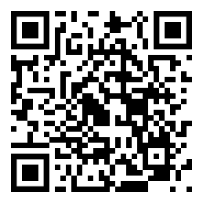
PASS Marathon: Spanish February 21, 2019 - 17:00 UTC
The very first PASS Marathon: Spanish Edition will take place on
February 21, 2019 at 17:00 UTC. Don't miss the opportunity to attend this virtual event, featuring exclusive content from PASS Community Leaders and other experts who utilize the Microsoft Data Platform, all in Spanish.
Register Now
pass.org/marathon/2019/spanish/Inicio.aspx

Slide 6

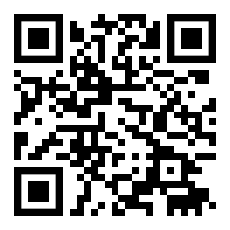
Microsoft Roadshow SQL Server and Azure Data Services
Register for a SQL Server and Azure Data Services free event near you! Hear SQL Server Engineering leaders and event partners share new innovations in SQL Server 2019, Azure Data Services, hardware and services, Linux, and more!
Join Microsoft leadership and event partners as they share why data investment is so critical to your digital transformation, and how you can harness data and AI to take the lead in your industry. You’ll even have the opportunity to network with industry peers and take part in executive briefings with senior Microsoft leadership.
Learn More
aka.ms/sql19roadshow

Slide 7


Upcoming SQLSaturdays
US/Canada
#837 Winnipeg – Mar 02, 2019
#826 Victoria – Mar 16, 2019
#825 Chicago – Mar 23, 2019
#859 Tampa – Mar 23, 2019
#822 Spokane – Mar 23, 2019
#846 Richmond – Mar 30, 2019
#827 Cincinnati – Mar 30, 2019
#813 Boston – BI Edition – Mar 30, 2019
LATAM
#819 Brasilia – Mar 30, 2019
EMEA
#816 Iceland – Mar 16, 2019

Slide 8

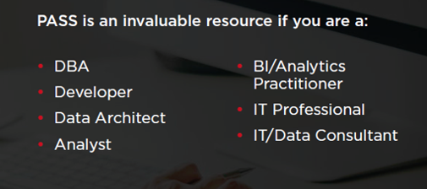
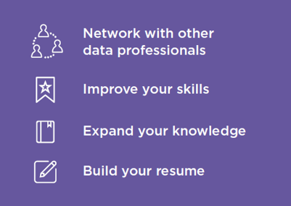

Join PASS to Grow Your Career
Connect with a global network of 250,000+ data professionals
Become a member and gain free access to:
Online educational content
Live webinars
In-person meetups, events, and conferences
Networking, volunteering, and speaking opportunities
The Community
The Benefits
… Join Today!
Notes:
PASS is a global, not-for-profit association where data professionals Connect, Share and Learn.
Joining PASS is free, and gives you access to hundreds of hours of free online content, live virtual and in-person events, the ability to join Local Groups in your area, and an annual conference, PASS Summit.
PASS is a great way to connect with like-minded professionals, increase your technical expertise, and grow your career.

Slide 9

Tech news
Azure Data Studio 1.4.5 (February release)
Azure Data Studio is complementary to SQL Server Management Studio with experiences around query editing and data development, while SQL Server Management Studio still offers the broadest range of administrative functions, and remains the flagship tool for platform management tasks.
Key highlights for the release:
* Added Compatibility Profiler filtering for XE
* Added Save as XML
* Added Data-Tier Application Wizard improvements
Download link
More information

Slide 10

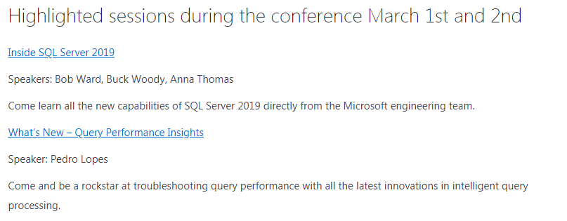
SQL Bits 2019 February 27-March 2 in Manchester, UK!
Is the Largest SQL Server professional gathering in Europe.
Community leaders share their real world experience and
Microsoft product teams providing deep insights into
Microsoft data solutions.
More information

Slide 11

SentryOne Plan Explorer Simplify Your SQL Server Query Tuning
Plan Explorer helps you quickly get to the root of the toughest SQL Server query problems.
Break through database performance barriers with advanced query tuning features not found in any other tool.
Plan Explorer is a single installation file containing the application and the SQL Server Management Studio (SSMS) add-in
Plan Explorer is Free to use.
You can download it from here:
https://www.sentryone.com/plan-explorer

Slide 12
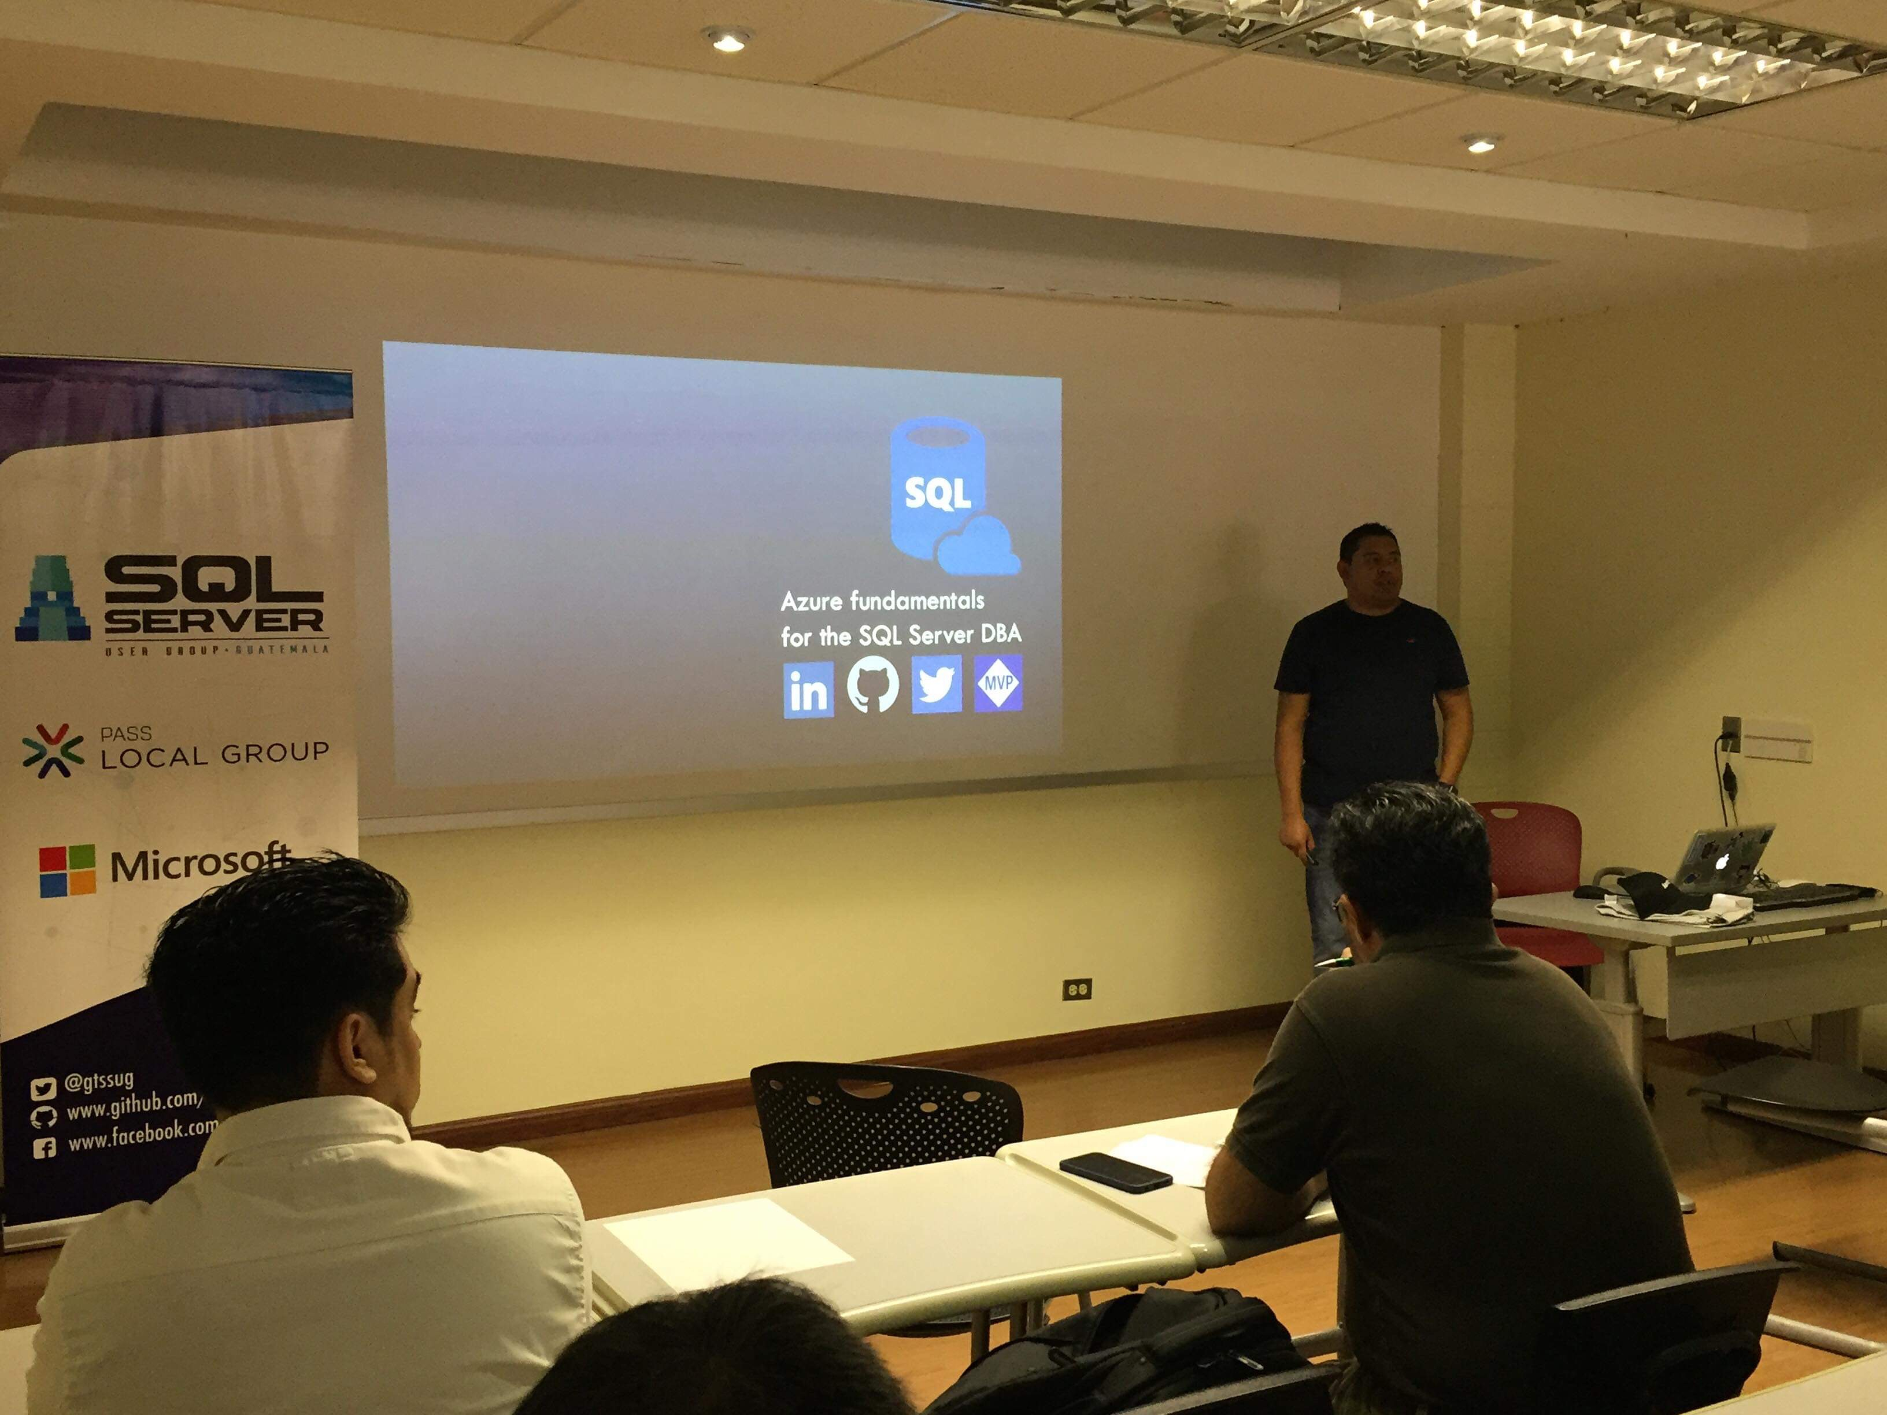
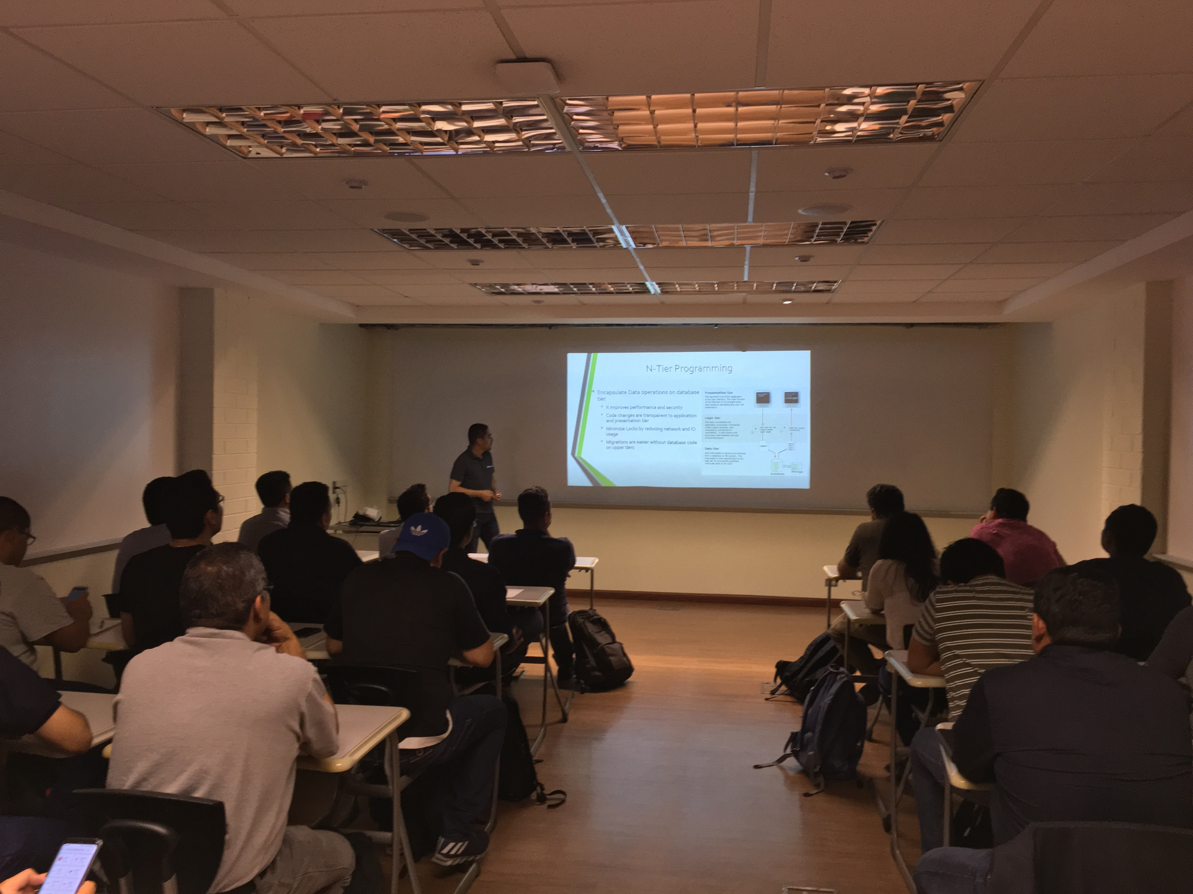
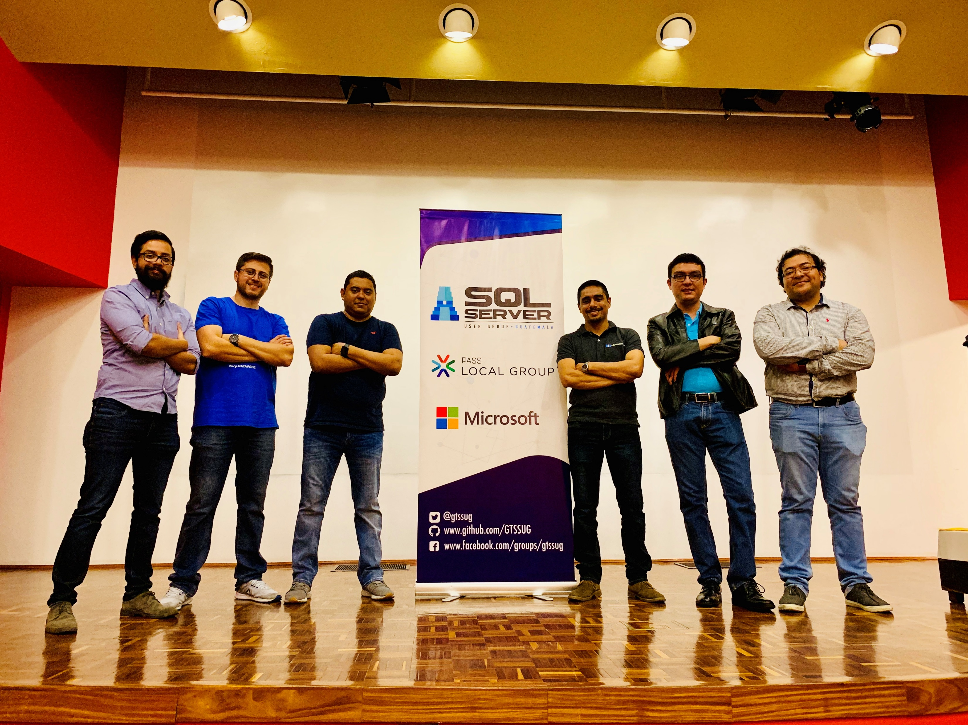
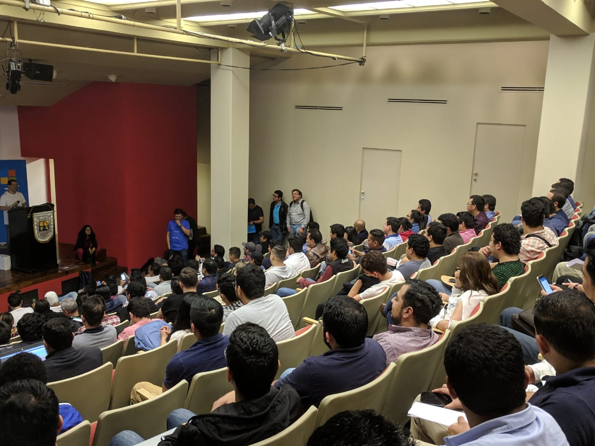
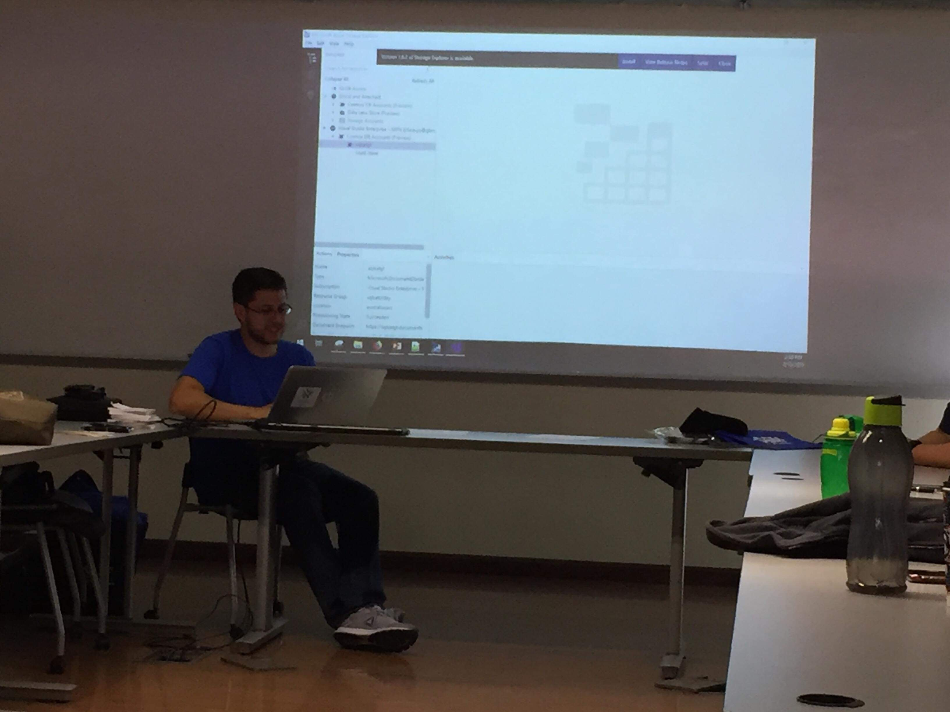
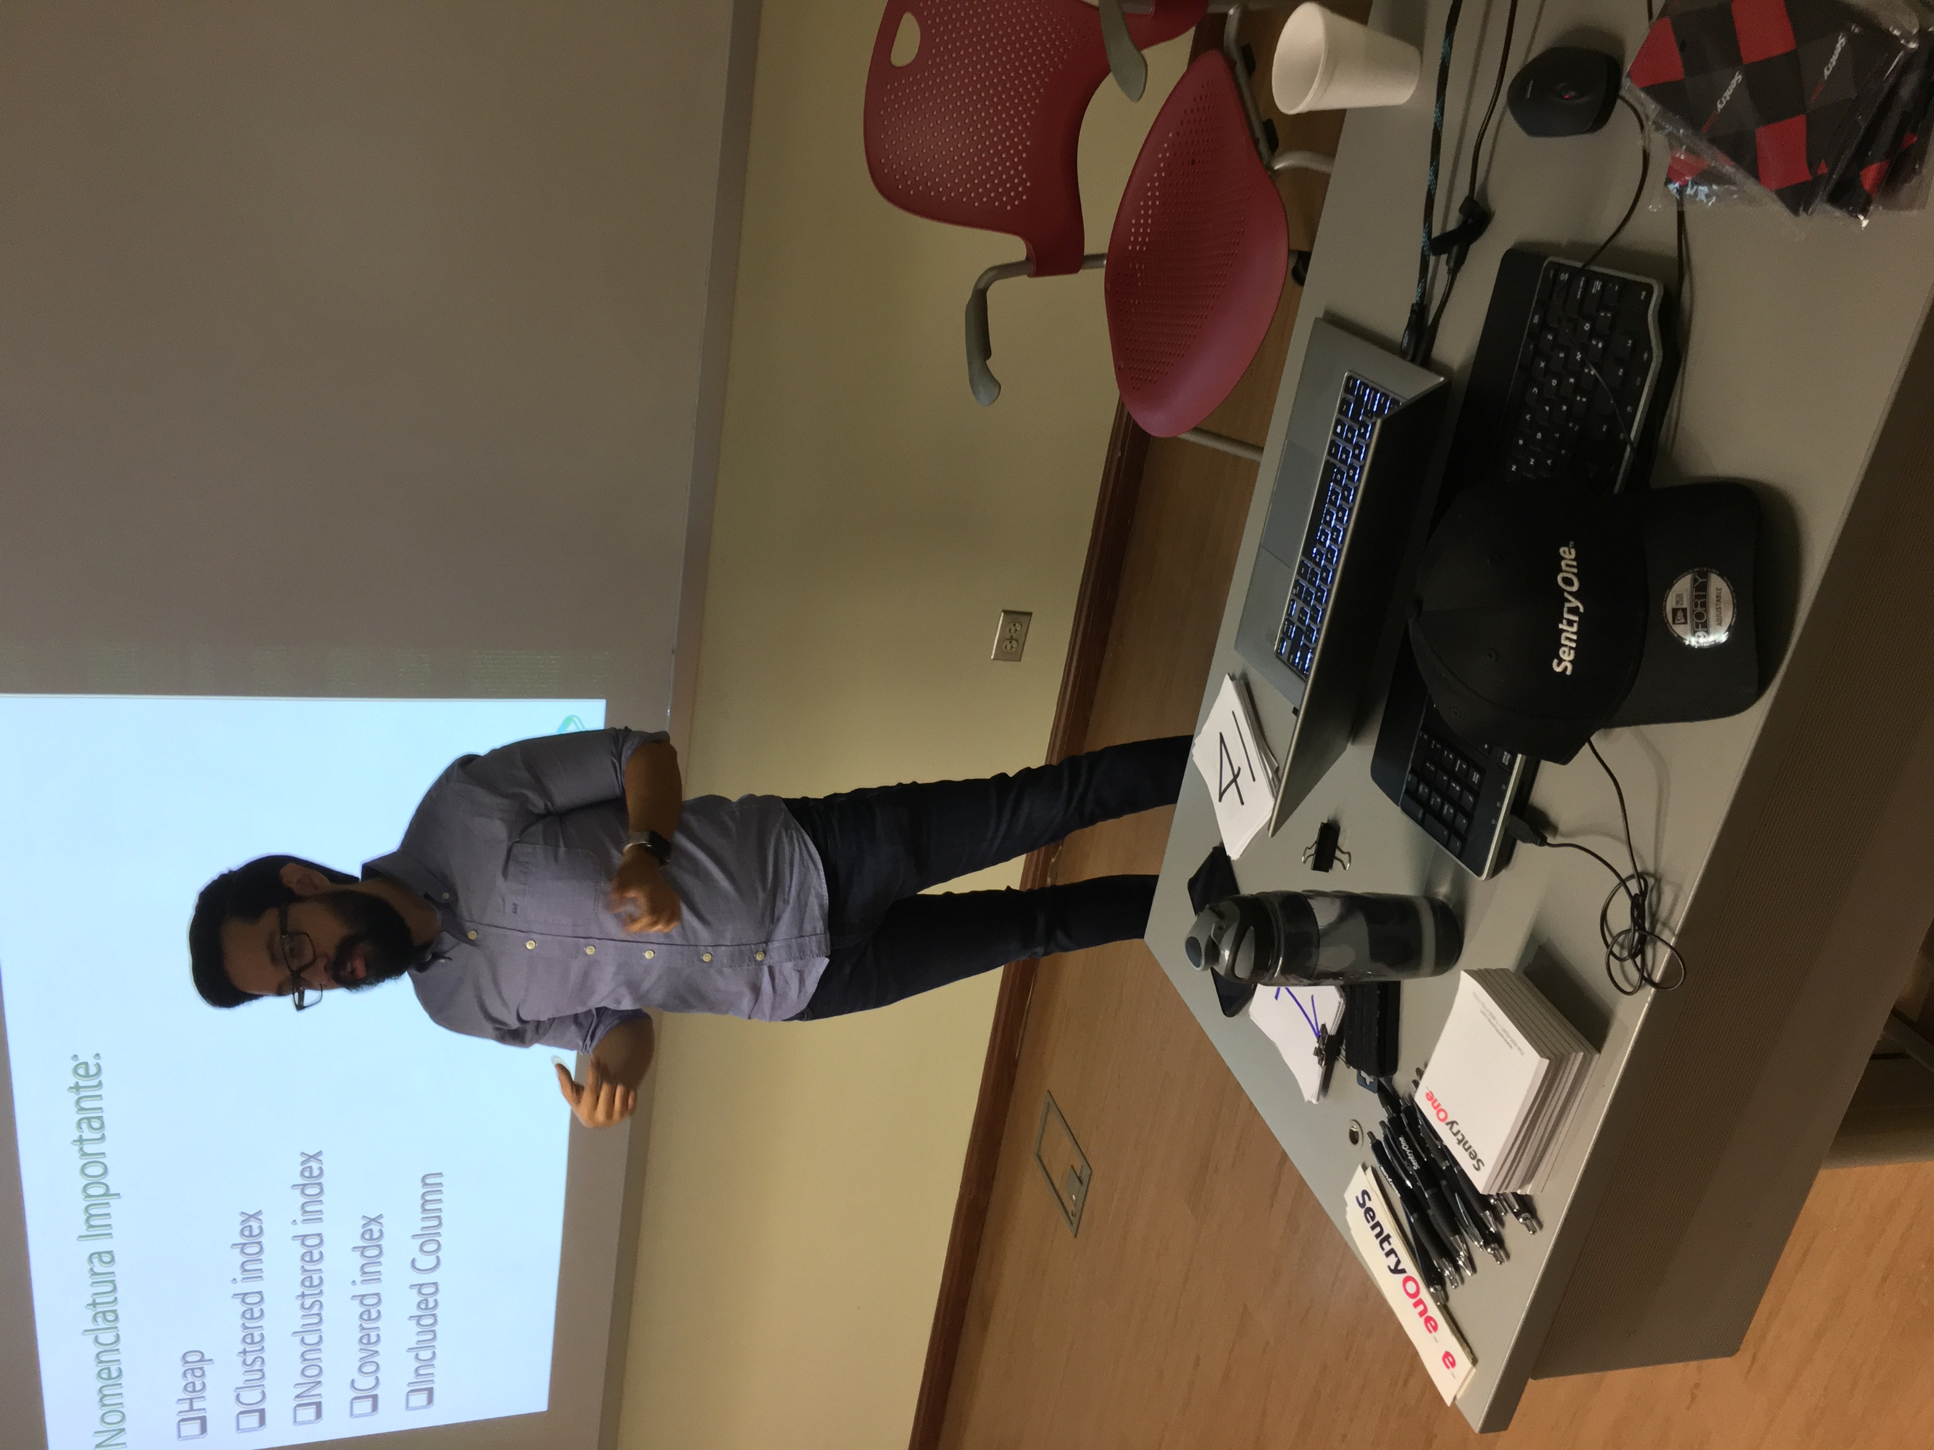
Community news
SQL Saturday #828 Guatemala

Slide 13
Call for speakers
Want to participate as speaker in the next Guatemala's SQL Server User Group meeting? Then fill out the online form with a brief description of your session here:
https://gtssug.pass.org/en-us/sessionsubmission.aspx

Slide 14



Sponsors
Want to become a sponsor? Send an email to: gtssug@pass.org

Slide 15




Follow us
Sign up for a free membership today at:
GTSSUG.PASS.org
#SQLPassGT @gtssug

Slide 16


Connect with PASS
Sign up for a free membership today at:
PASS.org
#sqlpass @sqlpass
@passcommunity

